Slide 1

Parts of Speech
Adverbs
All About

Slide 2
Adverbs
There are several kinds of adverbs:
Simple adverbs
Adverbs of time
Adverbs of manner
Adverbs of place
Adverbs of degree
Adverbs of frequency
Relative adverbs
Interrogative adverbs

Slide 3
Adverbs
Adverbs answer these questions.
How?
Lindsey quickly ran around the track.
How did she run? She ran quickly.
When?
The class started early today?
When did it start? It started early.
Where?
Please place your belongings here.
Where do you place them? You place them here.

Slide 4
Adverbs
Adverbs modify or describe verbs, adjectives, and other adverbs in a sentence.
Examples:
The baby cried loudly.
Loudly modifies the verb cried.
She wrote a very good essay.
Very modifies the adjective good.
He performed rather exceptionally today.
Rather modifies the adverb exceptionally.

Slide 5
Simple Adverbs
Simple adverbs typically end in –ly.
The kinds of simple adverbs are:
Adverbs of time
Adverbs of manner
Adverbs of place
Adverbs of degree
Adverbs of frequency

Slide 6
Adverbs of Time
Adverbs of time describe when things happen.
They are usually placed at the beginning or the end of a sentence.
Adverbs of time talk about the past, present, and future.
Examples:
Afterwards, now, soon, then, yesterday

Slide 7
Adverbs of Time
Here are a few examples of adverbs of time.
Past | Present | Future
yesterday ago the day before last week last month last year | when while still yet today now | soon then tomorrow next week next month next year later
These can be used to discuss the past, present, and future.
already, finally, before, after, eventually

Slide 8
Adverbs of Time
More examples:
I cleaned my room yesterday.
I am still cleaning my room.
I will clean my room tomorrow.
These adverbs modify the verb clean
Last week, I went to the mall.
I am going to the mall today.
I need to visit the mall next week.
These adverbs modify the verb went/going/need

Slide 9

Adverbs of Time
Write a sentence with an adverb of time to describe this picture.

Slide 10
Adverbs of Manner
Adverbs of manner describe how something is done or how something happens.
Most adjectives of manner end in –ly.
sadly, happily, angrily, cheerfully, etc.
Some adjectives of manner do not.
fast, well, hard

Slide 11
Adverbs of Manner
More examples.
The baseball player hit the ball hard.
Modifies the verb hit.
People walked slowly across the intersections.
Modifies the verb walked.

Slide 12
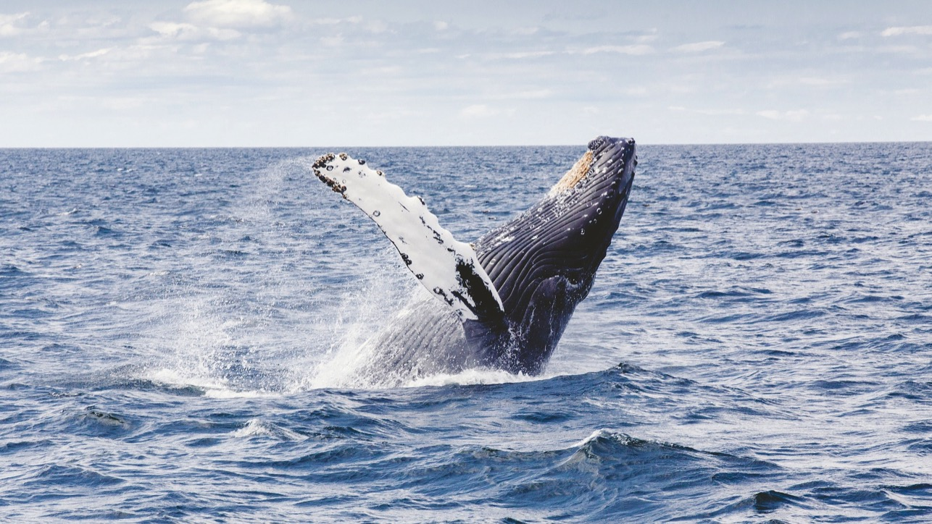
Adverbs of Manner
Write a sentence with an adverb of manner to describe this picture.

Slide 13
Adverbs of Place
Adverbs of place indicate where the action occurs.
These adjectives are placed after the verb or at the end of the sentence.
Examples:
inside, outside, above, below, here, there

Slide 14
Adverbs of Place
More examples:
We should wait here for more instructions.
Modifies the verb wait.
The statue was knocked over by the child.
Modifies the verb knocked.
A small kitten looked around for its mother.
Modifies the verb looked.

Slide 15
Adverbs of Place
It is easy to confuse adverbs of place with prepositions. If the word is a preposition, it must be followed by a noun.
Word | Adverb of Place | Preposition
by | His mother stopped by. | His mother lives by the lake.
down | The soccer player fell down. | The hiker slowly walked down the mountain.
around | She turned around and walked the other way. | She walked around the corner to her destination.
behind | The teacher warned the students not to fall behind. | The cat lost its toy behind the sofa.

Slide 16
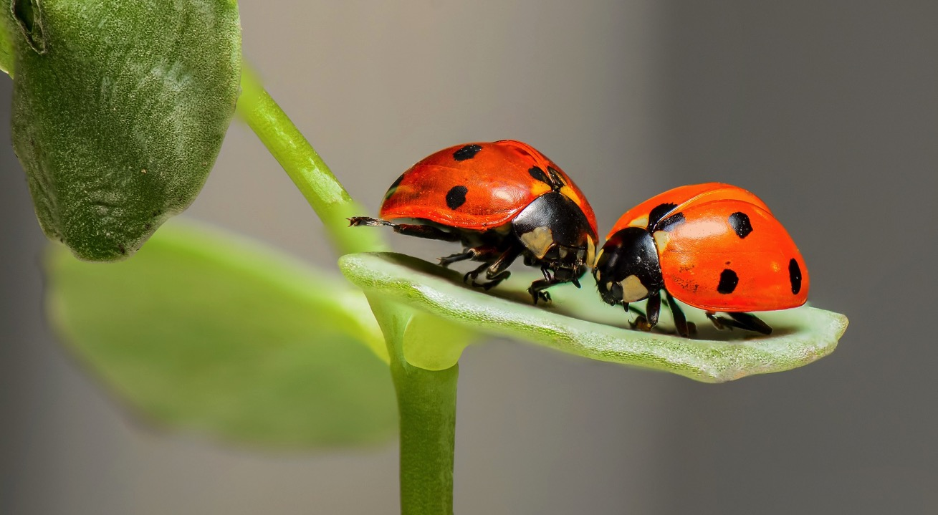
Adverbs of Place
Write a sentence with an adverb of place to describe this picture.

Slide 17
Adverbs of Degree
Adverbs of degree explain the extent in which something is done or happens.
Examples:
too, very, almost, nearly, really, quite

Slide 18
Adverbs of Degree
More examples:
I am almost finished eating my lunch.
Modifies the verb finished.
The puppy nearly fell in the pool when it was chasing a ball.
Modifies the verb fell.
After the breakup, the teenage boy was very sad.
Modifies the adjective sad.

Slide 19
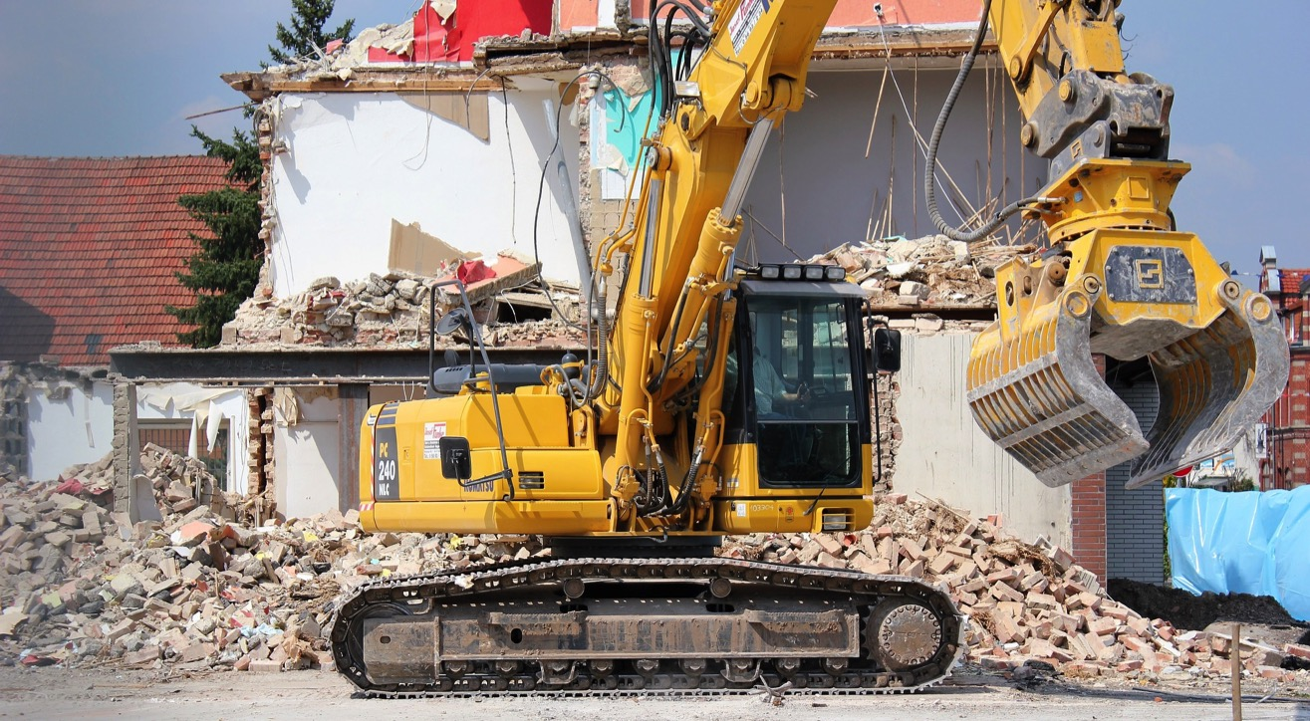
Adverbs of Degree
Write a sentence with an adverb of degree to describe this picture.

Slide 20
Adverbs of Frequency
Adverbs of frequency explain how often an action occurs.
They are usually placed before the main verb and after the auxiliary verb.
Examples:
always, often, sometimes, rarely, never

Slide 21
Adverbs of Frequency
More examples:
She rarely eats chocolate.
Modifies the verb eats.
Mr. Winchester is always late.
Modifies the verb is.
Sara usually scores well on her math exams.
Modifies the verb scores.

Slide 22
Adverbs of Frequency
Adverbs of frequency can also be placed at the beginning or end of a sentence; this placement makes the meaning stronger. *Notice comma placement.
Adverb | Weaker Position | Stronger Position
normally | I normally don’t eat sushi. | I don’t eat sushi normally.
occasionally | I occasionally text my friends. | Occasionally, I text my friends.
often | I often forget to do my homework. | I forget to do my homework often.
frequently | I frequently visit the memorial. | I visit the memorial frequently.
usually | I usually volunteer at the animal shelter on Sundays. | Usually, I volunteer at the animal shelter on Sundays.

Slide 23
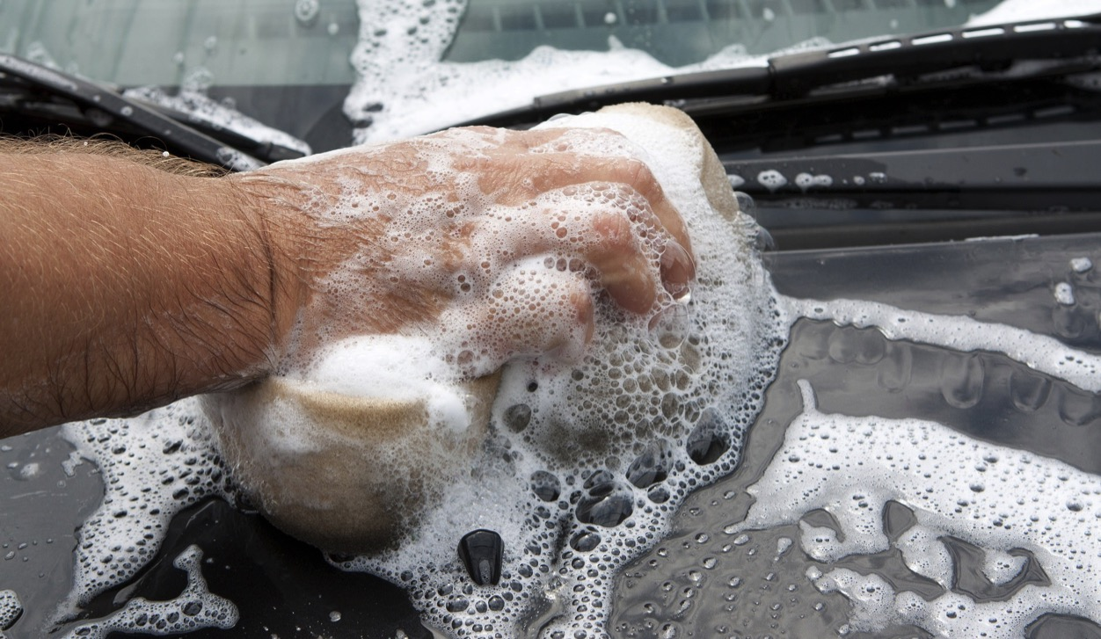
Adverbs of Frequency
Write a sentence with an adverb of frequency to describe this picture.

Slide 24
Relative Adverbs
Relative adverbs are adverbs that introduce a clause, or a group of words.
Relative adverbs can replace a relative pronoun and preposition in a sentence to be less formal.
Examples:
where, when, why, how, whatever, wherever

Slide 25
Relative Adverbs
Less Formal
More Formal
Relative Adverb
This is the bakery where I bought my cake.
I remember the day when I learned to ski.
Tell me (the reason) why I can’t go home.
Relative Pronoun & Prep.
This is the bakery at which I bought my cake.
I remember the day on which I learned to ski.
Tell me the reason for which I can’t go home.

Slide 26
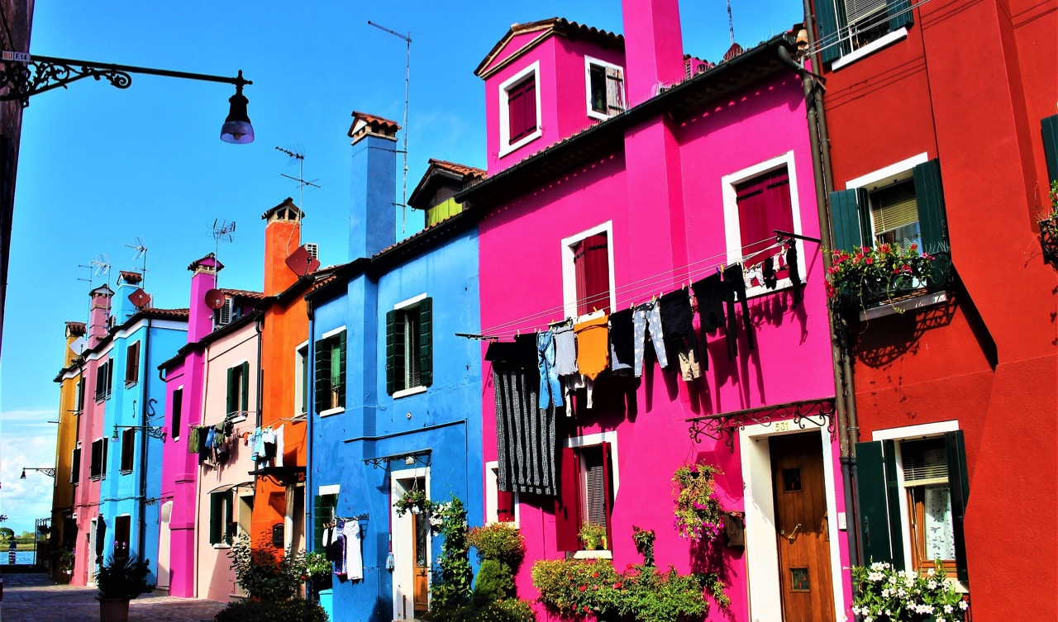
Relative Adverbs
Write a sentence with a relative adverb to describe this picture.

Slide 27
Interrogative Adverbs
Interrogative adverbs are placed at the beginning of a sentence to ask a question.
Examples:
why, where, how, when

Slide 28
Interrogative Adverbs
More examples:
Where is the pencil sharpener?
How are you feeling today?
When does Aunt Mae’s plane arrive?
Why are you late to class?

Slide 29

Interrogative Adverbs
Write a sentence with an interrogative adverb to describe this picture.

